Slide 1
Virtual Mouse
Presented by
Bhagyashree G. Mohane
Arjun Singh Rahal
Aarohi A. Mhaisalkar

Slide 2
Index
Introduction
Requirements
System Design
Flow Diagram
Working
Mouse Controls
Software Testing
Features
Conclusion

Slide 3
Introduction
A virtual mouse is software that allows users to give mouse inputs to a system without using an actual mouse.
The main objective of the proposed system is to perform computer mouse cursor functions and scroll function using a web camera or a built-in camera in the computer instead of using a traditional mouse device.

Slide 4
System Environment
Hardware
Software
Processor : Intel Pentium IV
Main Memory : 512 MB RAM
Hard Disk : 80 GB
Mouse : Standard two button or higher
Display : 15” Monitor
Other devices : Modem
Operating System : Windows 2000/XP
Language Used : Python
Tools : Microsoft Visual Studio code
Other software : Figma

Slide 5
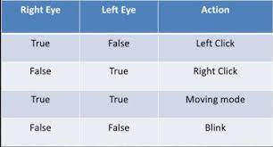
Eye Mouse Controls

Slide 6
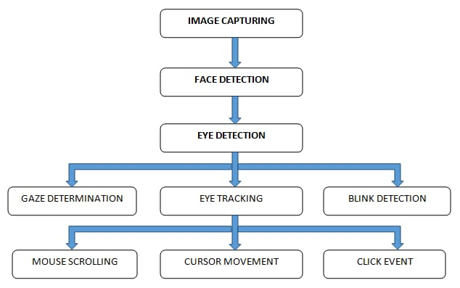
Working

Slide 7
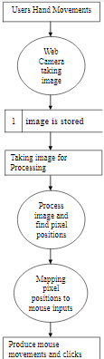
Flow Diagram

Slide 8
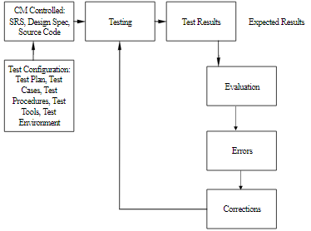
Software Testing
“VIRTUAL MOUSE” testing activity includes unit level testing, integration testing, performance testing (CI Qualification Testing), and acceptance testing (System Qualification Testing).

Slide 9
Features
Low System Requirements
Low Cost
High Compatibility
User Friendly
Application useful for handicapped people
Easier Computer Control

Slide 10
Conclusion
Eye Mouse is a very helpful tool which can replace a normal mouse device.
It’s simple , multipurpose and helpful in virtual or interactive computer gaming and advertisements.
A gift for Physically challenged people.

Slide 11
Thank you

